Slide 1
Chapter 7: Database Design and Entity-Relationship Model

Slide 2
Chapter 7: Database Design and Entity-Relationship Model
Design Process
Modeling
Constraints
E-R Diagram
Design Issues
Weak Entity Sets
Extended E-R Features
Design of the Bank Database
Reduction to Relation Schemas
Database Design
UML

Slide 3
Design Process
数据库系统开发生命周期
  数据库规划
    任务陈述、任务目标
  系统定义
    系统边界、用户视图
  需求的收集与分析
    用户需求：数据需求、事务需求
    系统需求
  数据库设计、DBMS选型、应用程序设计
  实现、构建原型(可选)
  数据转换与加载
  测试
  操作性维护

Slide 4
Design Process
数据库设计
  概念设计阶段
  逻辑设计阶段
  物理设计阶段
E-R 图的位置
  用于概念模型设计
E-R图的作用
  帮助澄清用户数据需求
  系统分析员和用户对数据需求达成一致
  数据逻辑模型设计的基础
E-R图的要求和评价标准
  清晰、易懂
  完整、精确、无二义
现实世界
理解、表达
E-R模型（概念设计）
转换、设计
关系模型（逻辑设计）
物理特征（物理设计）

Slide 5

E-R Diagrams
Rectangles represent entity sets.
Diamonds represent relationship sets.
Attributes listed inside entity rectangle
Underline indicates primary key attributes

Slide 6
Modeling
The world can be modeled as:
  a collection of entities,
  relationship among entities.
An entity is an object that exists and is distinguishable from other objects.
  Example: specific person, company, event, plant
Entities have attributes
  Example: people have names and addresses
An entity set is a set of entities of the same type that share the same properties.
  Example: set of all persons, companies, trees, holidays

Slide 7

Entity Sets instructor and student
instructor_ID instructor_name student-ID student_name

Slide 8
Relationship Sets
A relationship is an association among several entities
Example:
44553 (Peltier) advisor 22222 (Einstein)
student entity relationship set instructor entity
A relationship set is a mathematical relation among n ≥ 2 entities, each taken from entity sets
{(e₁, e₂, … e_{n}) | e₁ ∈ E₁, e₂ ∈ E₂, …, e_{n} ∈ E_{n}}
where (e₁, e₂, …, e_{n}) is a relationship
  Example:
  (44553,22222) ∈ advisor

Slide 9

Relationship Set advisor

Slide 10

Relationship Sets (Cont.)
An attribute can also be property of a relationship set.
For instance, the advisor relationship set between entity sets instructor and student may have the attribute date which tracks when the student started being associated with the advisor

Slide 11
Degree of a Relationship Set
binary relationship
  involve two entity sets (or degree two).
  most relationship sets in a database system are binary.
Relationships between more than two entity sets are rare. Most relationships are binary. (More on this later.)
  Example: students work on research projects under the guidance of an instructor.
  relationship proj_guide is a ternary relationship between instructor, student, and project

Slide 12

Roles
Entity sets of a relationship need not be distinct
  Each occurrence of an entity set plays a “role” in the relationship
The labels “course_id” and “prereq_id” are called roles.

Slide 13
Attributes
An entity is represented by a set of attributes, that is descriptive properties possessed by all members of an entity set.
  Example:
  instructor = (ID, name, street, city, salary )
  course= (course_id, title, credits)
Domain – the set of permitted values for each attribute
Attribute types:
  Simple and composite attributes.
  Single-valued and multivalued attributes
    Example: multivalued attribute: phone_numbers
  Derived attributes
    Can be computed from other attributes
    Example: age, given date_of_birth

Slide 14

Composite Attributes

Slide 15

Entity With Composite, Multivalued, and Derived Attributes

Slide 16

Relationship Sets with Attributes

Slide 17
Mapping Cardinality Constraints
Express the number of entities to which another entity can be associated via a relationship set.
Most useful in describing binary relationship sets.
For a binary relationship set the mapping cardinality must be one of the following types:
  One to one
  One to many
  Many to one
  Many to many

Slide 18

Mapping Cardinalities
One to one
One to many
Note: Some elements in A and B may not be mapped to any
elements in the other set

Slide 19

Mapping Cardinalities
Many to one
Many to many
Note: Some elements in A and B may not be mapped to any
elements in the other set

Slide 20

One-to-One Relationship
one-to-one relationship between an instructor and a student
  an instructor is associated with at most one student via advisor
  and a student is associated with at most one instructor via advisor

Slide 21
One-to-Many Relationship
one-to-many relationship between an instructor and a student
  an instructor is associated with several (including 0) students via advisor
  a student is associated with at most one instructor via advisor,

Slide 22
Many-to-One Relationships
In a many-to-one relationship between an instructor and a student,
  an instructor is associated with at most one student via advisor,
  and a student is associated with several (including 0) instructors via advisor

Slide 23
Many-to-Many Relationship
An instructor is associated with several (possibly 0) students via advisor
A student is associated with several (possibly 0) instructors via advisor

Slide 24
Keys
A super key of an entity set is a set of one or more attributes whose values uniquely determine each entity.
A candidate key of an entity set is a minimal super key
  ID is candidate key of instructor
  course_id is candidate key of course
Although several candidate keys may exist, one of the candidate keys is selected to be the primary key.

Slide 25
Keys for Relationship Sets
The combination of primary keys of the participating entity sets forms a super key of a relationship set.
  (s_id, i_id) is the super key of advisor
Must consider the mapping cardinality of the relationship set when deciding what are the candidate keys
Need to consider semantics of relationship set in selecting the primary key in case of more than one candidate key

Slide 26
Primary Key of Relationship Set

Slide 27
Primary Key of Relationship Set (Cont.)

Slide 28
Participation of an Entity Set in a Relationship Set
Total participation (indicated by double line): every entity in the entity set participates in at least one relationship in the relationship set
  Example: participation of student in advisor is total
Partial participation: some entities may not participate in any relationship in the relationship set
  Example: participation of instructor in advisor is partial

Slide 29
练习1
一个工厂需要管理下列信息：
  工厂有许多职工，每个职工有职工号、姓名、年龄、性别；
  工厂内有多个车间，每个车间有车间号、车间地址和电话，一个车间有一名车间主任，多名职工，一个职工不能同时属于多个车间；
  一个车间生产多种产品，产品有产品号和价格；
  一个产品由多种零件组成，一种零件也可以参与装配多种产品；
  产品与零件均存入仓库中；
  一个工厂有多个仓库，仓库有仓库号、仓库地址和电话；每个仓库有一名仓库主任进行管理，同时可以有多名职工担任仓库保管。
请画出该系统的E-R图；并考虑如何转化为关系模式

Slide 30
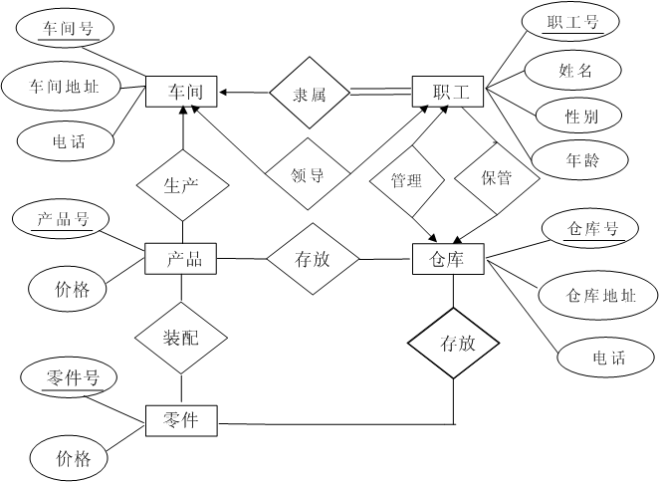

Slide 31

Alternative Notation for Cardinality Limits
Cardinality limits can also express participation constraints

Slide 32

E-R Diagram with a Ternary Relationship

Slide 33
弱实体集
accno
账户
AccrualRec
date
accName
accrual
Transaction
eno
eName
dealnum
银行职员
lineNo
date

Slide 34
弱实体集
背景示例：
上述问题的表示方法：
  属性实体化
  交易记录、利息记录属性实体化之后，实体无法独立标识
  行号、日期都只能在一个账户内分辨多值属性，缺少全局标识
accno
账户
AccrualRec
date
accName
accrual
Transaction
eno
eName
dealnum
银行职员
lineNo
date

Slide 35
弱实体集
弱实体集提出的背景
  存在一些场景，需要表达：
    一个实体的属性与其它实体之间的关系
    或者属性之间相互的关联关系
  在表达属性参与的联系时，需要进行属性实体化
    某些属性实体化之后，实体可以独立标识，如电话；
    某些属性实体化之后，实体自身无标识属性，如账户交易
  属性实体化后，若不能独立标识，形成弱实体
弱实体定义
  没有足够属性标识的实体，称为弱实体
  反之称为强实体
  弱实体需要依赖属主实体而存在，不能独立存在

Slide 36
弱实体集
含有弱实体集的E-R图示例：
属主实体/标识性实体：弱实体依赖于属主实体存在
标识性联系：多对一、全部参与
分辨符：在属主实体范围内区分其它弱实体
弱实体的标识：属主实体标识(主码)+分辨符
accno
账户
利息记录
date
accName
accrual
计息
交易记录
操作
银行职员
lineNo
date
dealnum
eno
eName

Slide 37
Weak Entity Sets
An entity set that does not have a primary key is referred to as a weak entity set
The existence of a weak entity set depends on the existence of a identifying entity set
  It must relate to the identifying entity set via a total, one-to-many relationship set from the identifying to the weak entity set
  Identifying relationship depicted using a double diamond
The discriminator (or partial key) of a weak entity set is the set of attributes that distinguishes among all the entities of a weak entity set
The primary key of a weak entity set is formed by the primary key of the strong entity set on which the weak entity set is existence dependent, plus the weak entity set’s discriminator

Slide 38

Weak Entity Sets (Cont.)
We underline the discriminator of a weak entity set with a dashed line.
We put the identifying relationship of a weak entity in a double diamond.
Primary key for section – (course_id, sec_id, semester, year)

Slide 39

E-R Diagram for a University Enterprise

Slide 40
Reduction to Relational Schemas

Slide 41
Reduction to Relation Schemas
Entity sets and relationship sets can be expressed uniformly as relation schemas
Each schema has a number of columns (generally corresponding to attributes)

Slide 42
Representing Entity Sets With Simple Attributes
A strong entity set reduces to a schema with the same attributes
student(ID, name, tot_cred)
A weak entity set becomes a table that includes a column for the primary key of the identifying strong entity set
section ( course_id, sec_id, sem, year )

Slide 43
Representing Relationship Sets
A many-to-many relationship set is represented as a schema with attributes for the primary keys of the two participating entity sets, and any descriptive attributes of the relationship set
Example: schema for relationship set advisor
advisor = (s_id, i_id)

Slide 44
Redundancy of Schemas
Many-to-one relationship sets that are total on the many-side can be represented by adding an extra attribute to the “many” side
Example: Instead of creating a schema for relationship set inst_dept, add an attribute dept_name to the schema arising from entity set instructor

Slide 45
Redundancy of Schemas (Cont.)
One-to-one relationship sets, either side can be chosen to act as the “many” side, “total side” is prefer
If participation is partial on the “many” side, replacing a schema by an extra attribute in the schema corresponding to the “many” side could result in null values

Slide 46
Redundancy of Schemas (Cont.)
The schema corresponding to a relationship set linking a weak entity set to its identifying strong entity set is redundant.
  Example: The section schema already contains the attributes that would appear in the sec_course schema

Slide 47
练习2
一个工厂需要管理下列信息：
  工厂有许多职工，每个职工有职工号、姓名、年龄、性别；
  工厂内有多个车间，每个车间有车间号、车间地址和电话，一个车间有一名车间主任，多名职工，一个职工不能同时属于多个车间；
  一个车间生产多种产品，产品有产品号和价格；
  一个产品由多种零件组成，一种零件也可以参与装配多种产品；
  产品与零件均存入仓库中；
  一个工厂有多个仓库，仓库有仓库号、仓库地址和电话；每个仓库有一名仓库主任进行管理，同时可以有多名职工担任仓库保管。
请画出该系统的E-R图；并将其转化为关系模式

Slide 49
车间（车间号、车间地址、电话、车间主任职工号）
职工（职工号、姓名、性别、年龄、所属车间号）
仓库（仓库号、仓库地址、电话、仓库主任职工号）
产品（产品号、价格、生产车间号）
零件（零件号、价格）
仓库保管（职工号、仓库号）
产品存放（产品号、仓库号）
零件存放（零件号、仓库号）
装配（产品号、零件号）

Slide 50
Composite and Multivalued Attributes
Composite attributes are flattened out by creating a separate attribute for each component attribute
Ignoring multivalued attributes, extended instructor schema is
  instructor(ID,
  first_name, middle_initial, last_name,
  street_number, street_name,
  apt_number, city, state, zip_code,
  date_of_birth)

Slide 51
Composite and Multivalued Attributes
A multivalued attribute M of an entity E is represented by a separate schema EM
  Schema EM has attributes corresponding to the primary key of E and an attribute corresponding to multivalued attribute M
  Example: Multivalued attribute phone_number of instructor is represented by a schema:
  inst_phone= ( ID, phone_number)
    an instructor entity with primary key 22222 and phone numbers 456-7890 and 123-4567 maps to two tuples:
    (22222, 456-7890) and (22222, 123-4567)

Slide 52
Multivalued Attributes (Cont.)
Special case:entity time_slot has only one attribute other than the primary-key attribute, and that attribute is multivalued
  Optimization: Don’t create the relation corresponding to the entity, just create the one corresponding to the multivalued attribute
  time_slot(time_slot_id, day, start_time, end_time)

Slide 53

Design Issues
Use of entity sets vs. attributes
Use of phone as an entity allows extra information about phone numbers (plus multiple phone numbers)

Slide 54

Design Issues
Use of entity sets vs. relationship sets
Possible guideline is to designate a relationship set to describe an action that occurs between entities

Slide 55
Design Issues
Binary versus n-ary relationship sets
Some relationships that appear to be non-binary may be better represented using binary relationships
  E.g., A ternary relationship parents, relating a child to his/her father and mother, is best replaced by two binary relationships, father and mother
    Using two binary relationships allows partial information (e.g., only mother being know)
  But there are some relationships that are naturally non-binary
    Example: proj_guide

Slide 56

Converting Non-Binary Relationships to Binary Form
In general, any non-binary relationship can be represented using binary relationships by creating an artificial entity set.
  Replace R between entity sets A, B and C by an entity set E, and three relationship sets:
1. R_{A}, relating E and A 2. R_{B}, relating E and B
3. R_{C}, relating E and C
  Create a special identifying attribute e for E
  Add all attributes of R to E
  For each relationship (a_{i} , b_{i} , c_{i}) in R, create
1. a new entity e_{i} in the entity set E 2. add (e_{i} , a_{i} ) to R_{A}
3. add (e_{i} , b_{i} ) to R_{B} 4. add (e_{i} , c_{i} ) to R_{C}

Slide 57
分析示例：
上课（T-S-C）
教师 | 班级 | 课程
甲 | 1 | DB
甲 | 2 | DS
乙 | 1 | DS
乙 | 2 | DB
班级
S-T
S-C
上课
教师
T-C
课程
S-T |  |  | S-C |  |  | T-C
教师 | 班级 |  | 班级 | 课程 |  | 教师 | 课程
甲 | 1 |  | 1 | DB |  | 甲 | DB
甲 | 2 |  | 2 | DS |  | 甲 | DS
乙 | 1 |  | 1 | DS |  | 乙 | DS
乙 | 2 |  | 2 | DB |  | 乙 | DB

Slide 58
Extended ER Features

Slide 59
Extended E-R Features: Specialization
Top-down design process
Depicted by a triangle component labeled ISA (E.g., instructor “is a” person)
  The ISA relationship referred to as superclass - subclass relationship
Attribute inheritance – a lower-level entity set inherits all the attributes and relationship participation of the higher-level entity set to which it is linked

Slide 60

Specialization Example

Slide 61
Extended ER Features: Generalization
A bottom-up design process
Specialization and generalization are simple inversions of each other
The terms specialization and generalization are used interchangeably

Slide 62
Design Constraints on a Specialization/Generalization
Constraint on which entities can be members of a given lower-level entity set
  condition-defined
    Example: all customers over 65 years are members of senior-citizen entity set; senior-citizen ISA person.
  user-defined
Constraint on whether or not entities may belong to more than one lower-level entity set within a single generalization.
  Disjoint
    an entity can belong to only one lower-level entity set
    Noted in E-R diagram by having multiple lower-level entity sets link to the same triangle
  Overlapping
    an entity can belong to more than one lower-level entity set

Slide 63
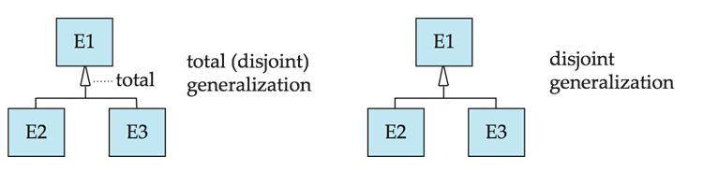
Design Constraints on a Specialization/Generalization (Cont.)
Completeness constraint -- specifies whether or not an entity in the higher-level entity set must belong to at least one of the lower-level entity sets within a generalization.
  total: an entity must belong to one of the lower-level entity sets
  partial: an entity need not belong to one of the lower-level entity sets

Slide 64

Aggregation
Consider the ternary relationship proj_guide, which we saw earlier
Suppose we want to record evaluations of a student by a guide on a project

Slide 65
Aggregation (Cont.)
Relationship sets eval_for and proj_guide represent overlapping information
  Every eval_for relationship corresponds to a proj_guide relationship
  However, some proj_guide relationships may not correspond to any eval_for relationships
    So we can’t discard the proj_guide relationship
Eliminate this redundancy via aggregation
  Treat relationship as an abstract entity
  Allows relationships between relationship and entity

Slide 66
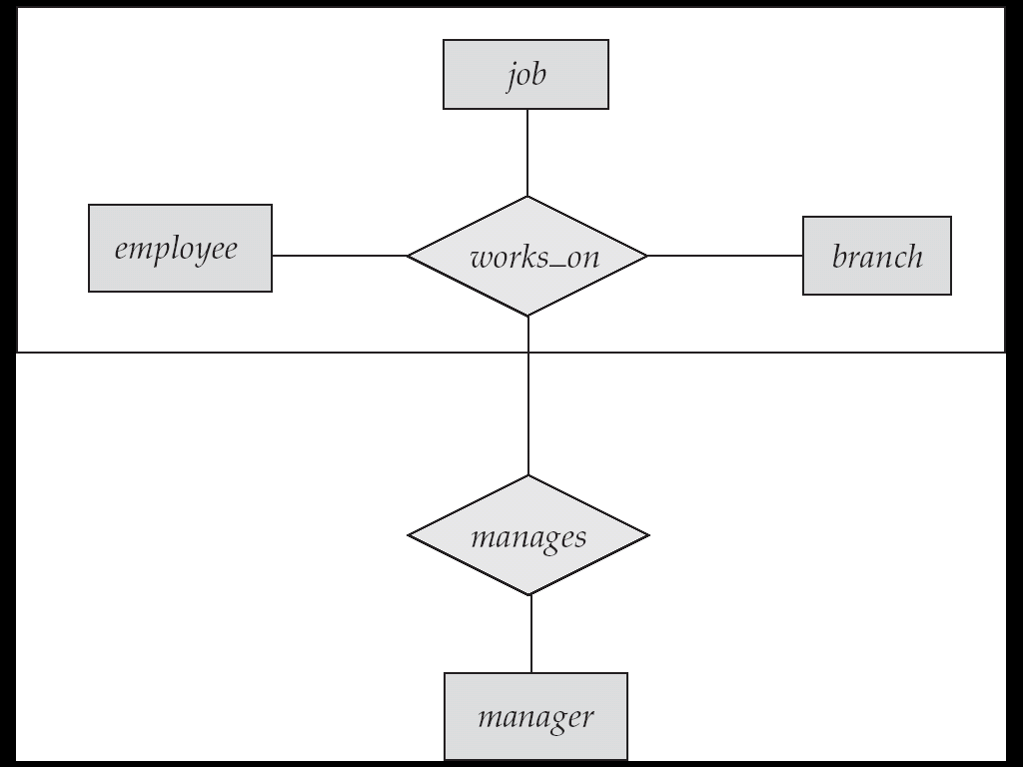

Aggregation (Cont.)
Without introducing redundancy, the following diagram represents:
  A student is guided by a particular instructor on a particular project
  A student, instructor, project combination may have an associated evaluation

Slide 67
Representing Specialization via Schemas
Method 1:
  Form a schema for the higher-level entity
  Form a schema for each lower-level entity set, include primary key of higher-level entity set and local attributes
  schema attributes
  person ID, name, street, city
  student ID, tot_cred
  employee ID, salary
  Drawback: getting information about, an employee requires accessing two relations, the one corresponding to the low-level schema and the one corresponding to the high-level schema

Slide 68
Representing Specialization as Schemas (Cont.)
Method 2:
  Form a schema for each entity set with all local and inherited attributes
  schema attributes
  person ID, name, street, city
  student ID, name, street, city, tot_cred
  employee ID, name, street, city, salary
  If specialization is total, the schema for the generalized entity set (person) not required to store information
    Can be defined as a “view” relation containing union of specialization relations
    But explicit schema may still be needed for foreign key constraints
  Drawback: name, street and city may be stored redundantly for people who are both students and employees

Slide 69
Schemas Corresponding to Aggregation
To represent relationship between aggregation and entity, create a schema containing
  primary key of the aggregated relationship,
  the primary key of the associated entity set
  any descriptive attributes

Slide 70
Schemas Corresponding to Aggregation (Cont.)
For example, to represent aggregation eval_for between relationship proj_guide and entity set evaluation, create a schema
eval_for (s_ID, project_id, i_ID, evaluation_id)
Schema proj_guide is redundant provided we are willing to store null values for attribute evaluation_id in relation on schema eval_for

Slide 71
E-R Design Decisions
The use of an attribute or entity set to represent an object.
Whether a real-world concept is best expressed by an entity set or a relationship set.
The use of a ternary relationship versus a pair of binary relationships.
The use of a strong or weak entity set.
The use of specialization/generalization – contributes to modularity in the design.
The use of aggregation – can treat the aggregate entity set as a single unit without concern for the details of its internal structure.

Slide 72

Summary of Symbols Used in E-R Notation

Slide 73
Symbols Used in E-R Notation (Cont.)

Slide 74

Alternative ER Notations
Chen, IDE1FX, …

Slide 75
Alternative ER Notations
Chen IDE1FX (Crows feet notation)

Slide 76
UML
UML: Unified Modeling Language
UML has many components to graphically model different aspects of an entire software system
UML Class Diagrams correspond to E-R Diagram, but several differences.

Slide 77

ER vs. UML Class Diagrams

Slide 78
ER vs. UML Class Diagrams
ER Diagram Notation
Equivalent in UML

Slide 79
UML Class Diagrams (Cont.)
Binary relationship sets are represented in UML by just drawing a line connecting the entity sets. The relationship set name is written adjacent to the line.
The role played by an entity set in a relationship set may also be specified by writing the role name on the line, adjacent to the entity set.
The relationship set name may alternatively be written in a box, along with attributes of the relationship set, and the box is connected, using a dotted line, to the line depicting the relationship set.

Slide 80
Exercises
Practice Exercises:
  7.1 7.2 7.3
Exercises:
  7.21 7.22 7.23

Slide 81
End of Chapter 7

